Slide 1



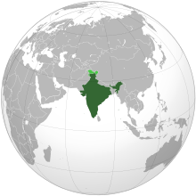


INDIAN CONSTITUTION

Slide 2
State Council of Ministers
State Council of Ministers is similar to Central Council of Ministers. The state council is headed by the Chief Minister. The council comprises ministers appointed by the governor on the recommendation of the CM.
How are the Council of Ministers appointed?
They are appointed by the governor on the advice of the CM. Governor also appoints a tribal affairs minister for the following states:
Chhattisgarh
Jharkhand
Madhya Pradesh
Odisha

Slide 3
Composition of Council of Ministers
The size of the council is not mentioned in the Indian Constitution. Chief Minister decides the size and the rank of the ministers as per the requirement in the State Legislature.
There are three categories of Council of Ministers:
Cabinet Ministers
Ministers of State
Deputy Ministers

Slide 4
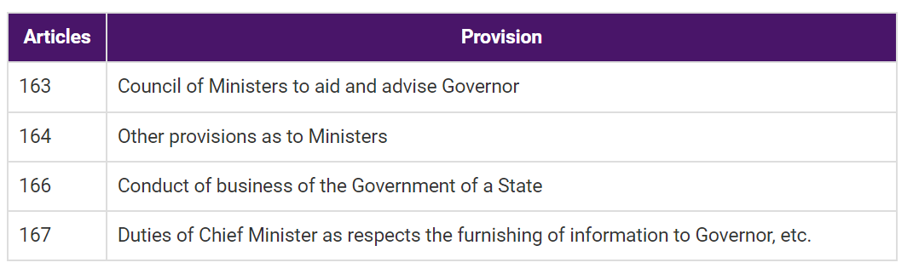
Articles related to State Council of Ministers

Slide 5
Qualifications
To be a Minister of a State Council, one should be a member of the State legislature, if he is not a member of state legislature while becoming a member of the state legislature, he has to become one within the period of six months from the date of entering the office.
Further, the qualifications needed to be a member of the state legislature are :
a) He must be a citizen of India.
(b) He must bear true faith and allegiance to the Constitution of India.
(c) He must be not less than 30 years of age in the case of the legislative council.
(d) He must not be less than 25 years of age in the case of the legislative assembly.

Slide 6
Appointment to the State Council of ministers
The Chief Minister is appointed by the governor.
The other ministers are appointed by the governor on the advice of the chief minister.
The governor can appoint only those persons as ministers who are recommended by the chief minister.
Removal
Members of the state council of ministers can hold office during the pleasure of the governor, but the governor exercises his power on the recommendation of the chief minister.

Slide 7
Role And Functions of State Council Of Ministers
Formulation of Policies
Ministers are in charge of formulating the government's policies.
The Cabinet makes decisions on all key issues, including public health, disability and unemployment benefits, plant disease control, water storage, land tenures and production, and the supply and distribution of goods.
The appropriate department implements the policy when it has been developed.

Slide 8
Administration and Maintenance of Public Order
The executive power must be used in a way that ensures that state laws are followed.
The Governor is empowered by the Constitution to create -rules for the more efficient conduct of government activities.
The Council of Ministers advises on all such regulations.

Slide 9
Guiding the Legislature
The majority of the bills voted by the legislature are government bills drafted by ministries.
The Ministers introduce, explain, and defend them before the State Legislature. Each year, before the start of the first session of the Legislature, the Cabinet prepares the Governor's Address, in which it lays out its legislative agenda.
Control over the State Exchequer
The Finance Minister presents the State Legislature with the State budget, which includes estimates of revenue and expenditure for the coming year.
In the case of a Money Bill, the Legislature cannot take the initiative.
Only a Minister can introduce such a Bill, which must be recommended by the Governor. The Executive does have the initiative regarding financial matters.

Slide 10
Execution of Central Laws and Decisions of the Union Government
In certain situations, the Union Government has the authority to issue directives to state governments.
States should use their executive power to guarantee that the laws passed by Parliament are followed.
They should not do anything that might jeopardize the Union's executive power.

Slide 11
-THANK YOU-

